Slide 1

A Project presentation on A Novel Approach To Enhance Crop Yield With Seed Quality Analysis And Machine Learning
Presented by Batch CSSE 25-19
N Naga Harika 21121A1581
S Abdul Razaq 21121A15A1
P Gurunath 21121A1583
M Shashank 18121A1561
Computer Science and Systems Engineering
Under the guidance of
Mrs. Ch. Prathima,
Assistant Professor,
Dept. of Data Science
HOD
Dr. P. K. Gupta,
Professor & Head,
Dept. of CSSE

Slide 2
Contents
Abstract
Introduction
Literature Survey
Existing System
Statement of the problem
Objectives
Motivation
Proposed System
Software and Hardware Requirements
Simulation Model
Analysis of Experimental Results
Implementation and Results
Conclusion

Slide 3
Abstract
Seed quality is one of the important determinants of crop yield and food security through different types of seeds. There are many challenges associated with conventional assessment of seed quality. To overcome the problems, a predictive system of seed quality evaluation using machine learning is proposed. The model extracts features from seed images, assessing parameters like size, shape, color, and texture of the seeds in order to minimize the decision-making errors of humans while classifying the seeds according to their quality.

Slide 4
Introduction
Seed segregation into quality types is one of the basic processes in agriculture and directly affects the viability and marketability of crops.
Good quality seeds are yielders of good crop while the low quality seed results in poor germination rates and poor growth.
Conventional seed separation techniques usually depend on visual examination and mechanical size grading-would often fall short in providing reliable quality assessments. Such methods are cumbersome and time-consuming and may result in unreliable quality assessments.

Slide 5
Introduction
The greatest potential in the improvement of seed segregation is through applying high image processing techniques and machine learning.
It will minimize the error and consistency of human choices, which will have only the best seeds selected for planting purposes.
Indeed, in fact, this application of machine learning to seed separation is a super type of agricultural processing that contributes to a better sustainable landscape for agriculture.

Slide 6
Literature Survey
[1] O. Erenstein, J. Chamberlin, and K. Sonder " Global maize production, consumption and trade: trends and R&D implications "
The paper analyzes global maize production trends from 2000 to 2020, highlighting a 45% increase in production.
The study emphasizes the need for R&D investments in maize production, focusing on yield improvement, disease resistance, and climate resilience.
The paper highlights the importance of sustainable production practices and climate-resilient varieties to mitigate the impacts of climate change.
Drawbacks:
The study focuses primarily on global trends, with limited analysis of regional-specific challenges and opportunities.
The study uses a limited dataset, which may not be representative of all regions or soil types.

Slide 7
Literature Survey
[2] G. Mariammal, " Prediction of Land Suitability for Crop Cultivation Based on Soil and Environmental Characteristics Using Modified Recursive Feature Elimination Technique "
The paper proposes a novel approach for predicting land suitability using a modified recursive feature elimination (MRFE) technique.
The MRFE technique effectively reduces dimensionality and identifies relevant features affecting land suitability.
The study identifies soil pH, organic carbon, and rainfall as critical factors affecting land suitability.
Drawbacks:
The study uses a limited dataset, which may not be representative of all regions or soil types.
The paper does not compare the performance of the MRFE technique with other feature selection methods.

Slide 8
Literature Survey
[3] G. Mariammal et al., " Machine Learning for Seed Quality Classification: An Advanced Approach Using Merger Data from FT-NIR Spectroscopy and X-ray Imaging "
The merger data from FT-NIR spectroscopy and X-ray imaging significantly improved the accuracy of seed quality classification.
The CNN algorithm achieved the highest accuracy of 97.5% in distinguishing between high-quality and low-quality seeds.
The RF algorithm achieved an accuracy of 95.5%, while the SVM algorithm achieved an accuracy of 93.5%.
Drawbacks:
The study requires specialized equipment such as FT-NIR spectroscopy and X-ray imaging machines.
The study uses a limited dataset, which may not be representative of all seed types and qualities.

Slide 9
Literature Survey
[4] A. D. de Medeiros et al. " Trends and Prospect of Machine Vision Technology for Stresses and Diseases Detection in Precision Agriculture "
Machine learning algorithms achieve high accuracy in distinguishing between high-quality and low-quality seeds.
Advanced sensor technologies, including hyperspectral and multispectral imaging, have improved the accuracy of stress and disease detection.
Various image processing techniques, such as convolutional neural networks (CNNs), have been developed for stress and disease detection.
Drawbacks:
Data quality can be affected by various factors, including weather conditions, soil type, and crop variety.
Machine vision models may not be generalizable to different crop types, environments, and regions.

Slide 10
Existing System
Existing System :
Manual Visual Inspection
Basic Mechanical Size Grading
Human-dependent Quality Assessment
Drawbacks of Existing System:
Reliability Issues
Efficiency Problems
Market Challenges

Slide 11
Problem Statement
Traditional seed quality assessment methods rely heavily on manual visual inspection and basic mechanical grading, which are both time-consuming and prone to human error. These conventional techniques lack standardization, consistency, and the ability to detect subtle quality indicators that affect seed viability. The process is labor-intensive, subjective, and inefficient for modern agricultural demands, leading to unreliable quality assessments and potential crop yield losses. With increasing market competition and the need for sustainable agriculture, there's an urgent need to automate and improve seed quality assessment through more accurate, efficient, and standardized methods. The current system's limitations directly impact agricultural productivity, resource optimization, and market competitiveness, making it crucial to develop a more reliable and automated solution.

Slide 12
Objectives
Automate Seed Quality Assessment
To Develop a predictive system using machine learning
Minimize human decision-making errors
Streamline the classification process
Enhance Quality Analysis
Extract key features from seed images (size, shape, color, texture)
Implement accurate quality classification
Ensure consistent evaluation standards
Improve Efficiency
Reduce manual inspection time
Automate seed segregation
Provide real-time insights to farmers

Slide 13
Objectives
Optimize Resource Usage
Make farming more sustainable
Improve profitability
Enhance crop yield through better seed selection
Standardize Quality Control
Create uniform assessment criteria
Increase reliability in seed classification
Meet modern market demands

Slide 14
Motivation
The motivation for this research stems from the crucial role of seed quality in determining crop yield and ensuring food security. Traditional manual inspection methods are increasingly inadequate for modern agricultural challenges, leading to inconsistent results and economic losses. With recent advances in machine learning and image processing technologies, there is a timely opportunity to automate and standardize seed quality assessment. The agricultural sector urgently needs a reliable system that can provide accurate, real-time quality assessments to improve crop yields, reduce waste, and enhance profitability. By developing an automated solution, this research aims to address the growing demands of sustainable agriculture while helping farmers optimize their resources and remain competitive in modern markets.

Slide 15
Proposed System
The proposed system aims to classify Soya Bean seeds based on their quality into five classes: Broken, Immature, Intact, Skin-Damaged, and Spotted. The system combines the feature extraction power of DenseNet with the classification accuracy of an InceptionV3-based custom model to achieve high performance. The workflow starts with pre-processing and augmentation of maize seed images, followed by feature extraction and classification.
Key Features
Feature Extraction using DenseNet:
DenseNet is employed as a feature extractor to capture complex patterns from Soya seeds images, including shapes, textures, and distinguishing characteristics.

Slide 16
Proposed System
InceptionV3-Based Classifier:
The extracted features are fed into a custom InceptionV3-inspired fully connected neural network that classifies the images into five distinct categories.
Optimization Techniques:
Batch Normalization and Dropout are employed to improve generalization and prevent overfitting.
Early stopping and model checkpointing help identify the best-performing model without overfitting.

Slide 17
Proposed System
Model Evaluation: The system evaluates classification performance using metrics such as accuracy and a detailed classification report. To evaluate the model's effectiveness, various performance metrics are computed:
a. Accuracy
Measures the percentage of correctly classified instances.
Computed for both training and validation datasets to assess model performance during training.
b. Loss
Cross-entropy loss is monitored during training to measure how well the model is learning.
Lower validation loss compared to training loss typically indicates a well-generalized model.
c. Classification Report
Generated using sklearn.metrics.classification_report() which provides:

Slide 18
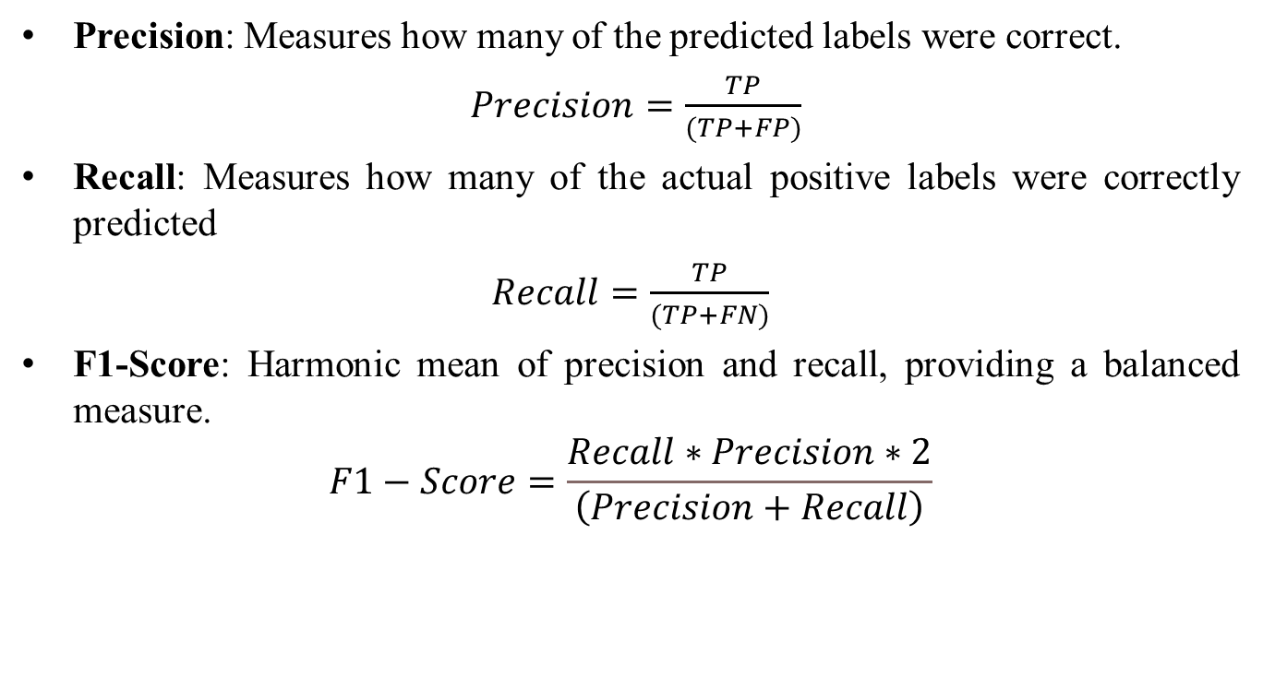
Proposed System
Precision: Measures how many of the predicted labels were correct.
$Precision=\frac{TP}{(TP+FP)}$
Recall: Measures how many of the actual positive labels were correctly predicted
$Recall=\frac{TP}{(TP+FN)}$
F1-Score: Harmonic mean of precision and recall, providing a balanced measure.
$$F1−Score=\frac{Recall∗Precision∗2}{\left(Precision+Recall\right)}$$

Slide 19
Software And Hardware Requirements
Software Requirements
Operating System:
Windows 10 or 11 (64-bit)
Development Environment
Python 3.8 or later
Jupyter Notebook or VSCode
Libraries and Frameworks
TensorFlow 2.0+
Keras
scikit-learn
Matplotlib
NumPy
Joblib

Slide 20
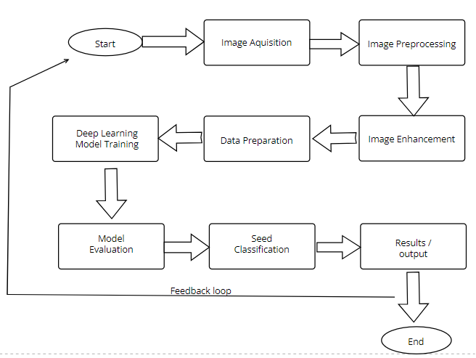
Simulation Model

Slide 21
DATA SET
The dataset includes five-type of individual soybean seed images, totaling 5513: intact, spotted, immature, broken, and skin-damaged. The individual soybean images (227×227 pixels) were generated from the original soybean images (3072×2048 pixels) via an image-processing algorithm. And, these five types of soybean images were sorted according to the Standard of Soybean Classification (GB1352-2009).
The 5 classes are:
Broken
Immature
Intact
Skin Damaged
Spotted

Slide 22
Analysis of Experimental Results
Model | Accuracy | Precision | Recall | F1-Score
CNN | 81 | 80 | 80 | 80
DenseNet | 88 | 89 | 88 | 88
EfficientNet | 86 | 87 | 86 | 89
InceptionV3 | 92 | 91 | 90 | 90
MobileNet V2 | 89 | 89 | 88 | 88
NASNet | 89 | 88 | 88 | 88
ResNet | 88 | 89 | 88 | 88
VGG19 | 89 | 89 | 89 | 89

Slide 23
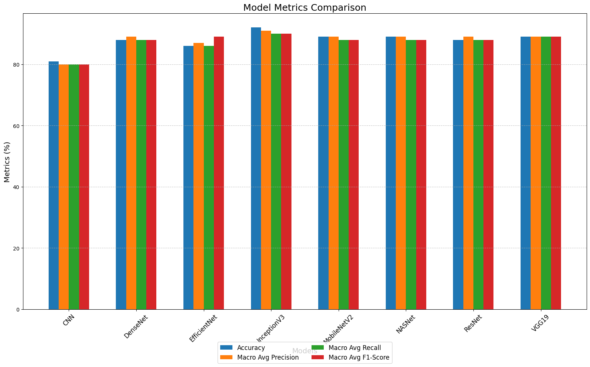
Analysis of Experimental Results

Slide 24
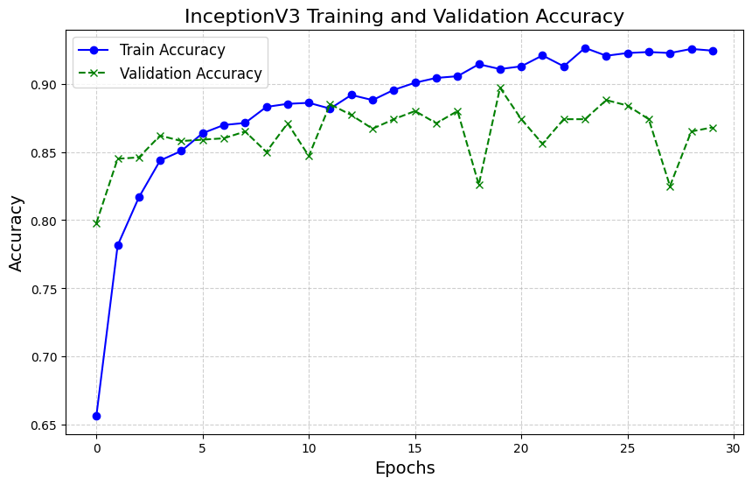
Analysis of Experimental Data

Slide 25
Analysis of Experimental Data
Inception V3 is a highly efficient and scalable deep learning architecture developed by Google, optimized for image classification and object recognition tasks. It builds on the Inception series by introducing several enhancements such as factorized convolutions, batch normalization, and label smoothing, which improve both speed and accuracy. The architecture features inception modules that stack multiple filter sizes in parallel, capturing spatial features at different resolutions simultaneously. Additionally, its reduced parameter count and efficient computation make it suitable for deployment on both high-performance and resource-constrained systems, offering a robust balance between accuracy and computational efficiency.

Slide 26
Implementation and Results
The project involved developing a seed quality classification system using Flask for the backend and a frontend with HTML, CSS, and JavaScript. The system utilized InceptionV3, a pre-trained deep learning model, to classify seed images into Good and Bad quality categories. The model achieved an impressive 92% accuracy with high precision, recall, and F1-score, making it the most effective among the models tested. The Flask backend handled image preprocessing, model inference, and returned the classification results, while the frontend allowed users to upload images and view predictions. The system efficiently performed image classification, reducing human errors and ensuring accurate seed grading. The project demonstrated the effectiveness of transfer learning in enhancing accuracy and reducing training time, making it suitable for real-world agricultural applications.

Slide 27
Project Implementation
Tech Stack:
Backend: Flask (Python)
Frontend: HTML, CSS, JavaScript
Model: InceptionV3 (Transfer Learning) for seed classification
Database: SQLite (for storing seed classification results)
Libraries Used: TensorFlow/Keras, NumPy, OpenCV, Pillow, Flask-CORS (for handling CORS issues)

Slide 28
Project Workflow
Image Upload (Frontend)
The user accesses the web interface and uploads a seed image for classification.
The frontend sends the image to the Flask backend via an HTTP POST request.

Slide 29
Project Workflow
Image Upload (Frontend)
The user accesses the web interface and uploads a seed image for classification.
The frontend sends the image to the Flask backend via an HTTP POST request.

Slide 30
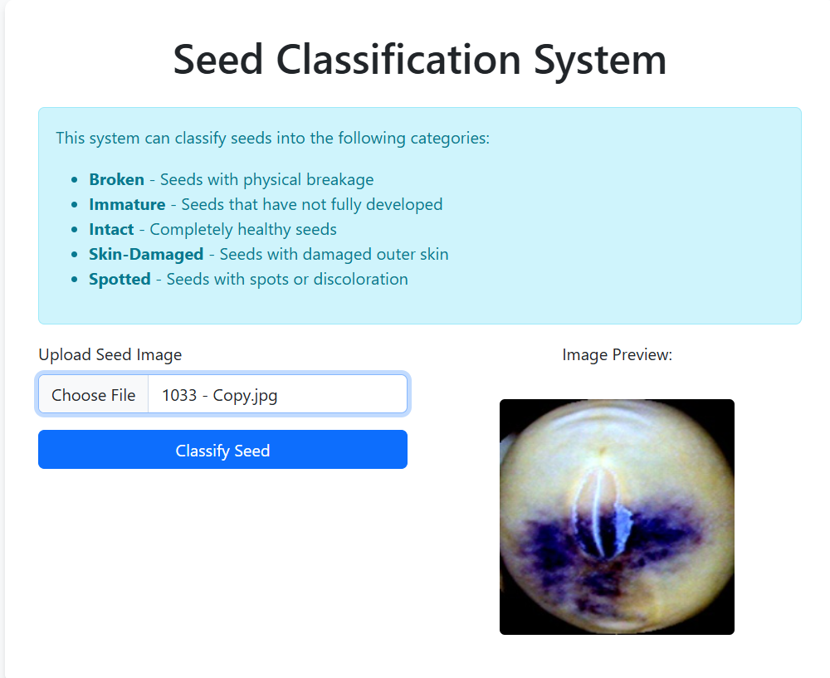
Project Workflow

Slide 31
Project Workflow
Preprocessing (Backend)
The Flask server receives the image and performs preprocessing, which includes:
Resizing the image to 299x299 pixels (required for InceptionV3).
Normalizing the pixel values between 0 and 1.
Converting the image to a NumPy array for model inference.

Slide 32
Project Workflow
Model Inference (Classification)
The InceptionV3 model predicts the quality of the seed image.
The model outputs a confidence score representing the probability of the image being classified as Good or Bad.
The backend sends the classification result and confidence score back to the frontend.

Slide 33
Project Workflow
Result Displayed (Frontend)
The frontend displays the result, showing whether the seed is classified as Good or Bad, along with the confidence score.
The image and its classification result are stored in the database for future reference.

Slide 34
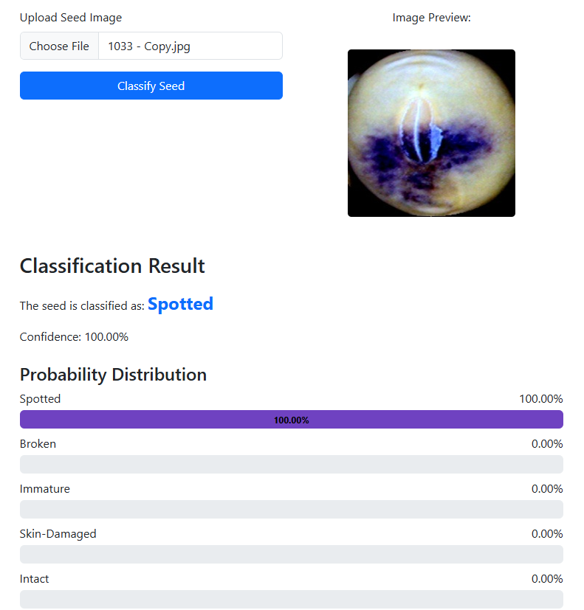
Project Workflow

Slide 35
Conclusion
As global food demand rises with population growth, ensuring high-quality seeds is crucial for sustainable agriculture and food security. Conventional methods of seed quality assessment are often time-consuming, inconsistent, and lack the precision required to meet modern agricultural demands. This project leverages machine learning and image processing to automate and enhance seed quality evaluation, reducing human error and increasing efficiency. By categorizing seeds based on essential quality metrics like color, shape, and texture, the proposed system aids in producing reliable, high-yielding crops, thus supporting farmers in meeting the increasing demand for quality produce.

Slide 36
Thank You

